Slide 1
Quantitative Finance
組員:
110061562 呂依凡 110061585 徐浩庭 110061571 林彥岑
Github link: https://github.com/EvanLu0815/labC_quantitativeFinance.git

Slide 2
Background Introduction
Understanding High Frequency Trading
Using algorithms to analyze trading data and execute trades in extremely short time.
Black Scholes Model
Developed in 1973, it is still regarded as one of the best ways for pricing an options contract

Slide 3
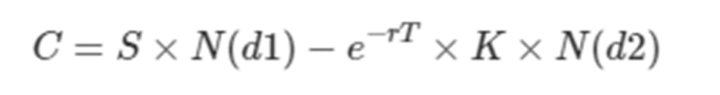
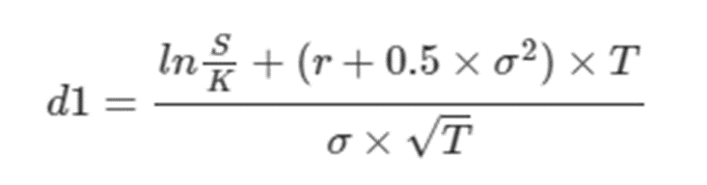
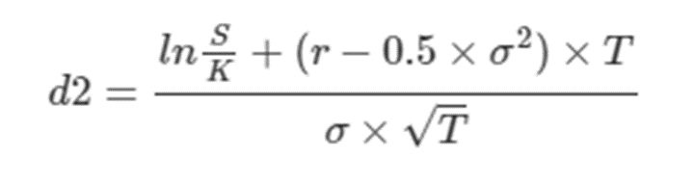
Black Scholes Model equation
Where
C: the theoretical price of call option
S: the stock price
N(): the cumulative normal distribution
r: the risk-free rate
T: the time to expiration
K: the strike price
σ: volatility

Slide 4
Black Scholes Model
Assumption
* Riskless rate: The rate of return on the riskless asset is constant and thus called the risk-free interest rate.
* The stock price follows a random walk in continuous time with a variance rate proportional to the square of the stock price
* The stock does not pay a dividend (股利)
* Ability to buy and sell any amount, even fractional, of the stock
* Ability to borrow and lend any amount, even fractional, of cash at the riskless rate.
* There are no transaction costs in buying or selling the stock or the option.

Slide 5
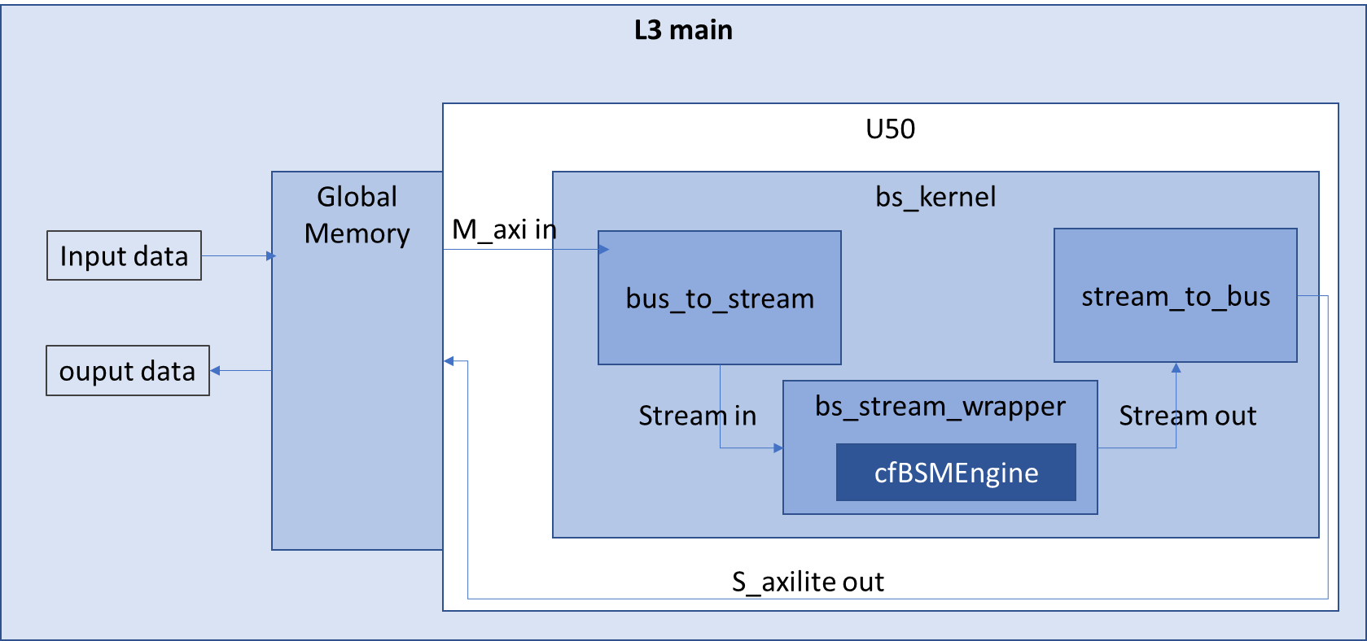
System Diagram

Slide 6
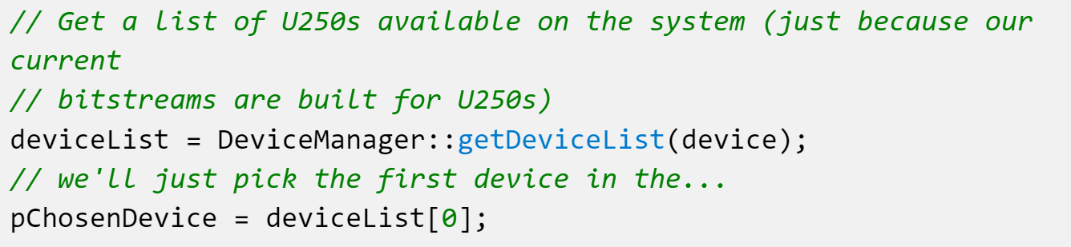
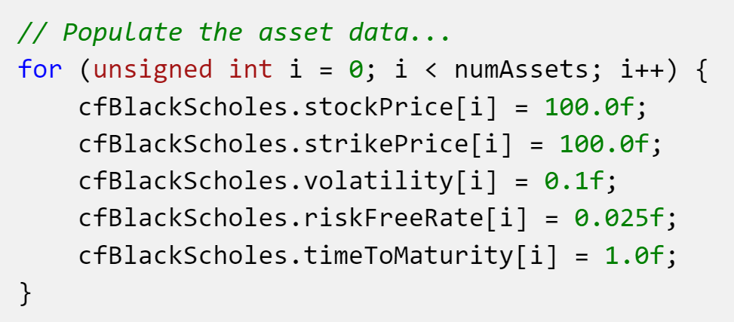
L3 Main
Pick device
Prepare test data

Slide 7

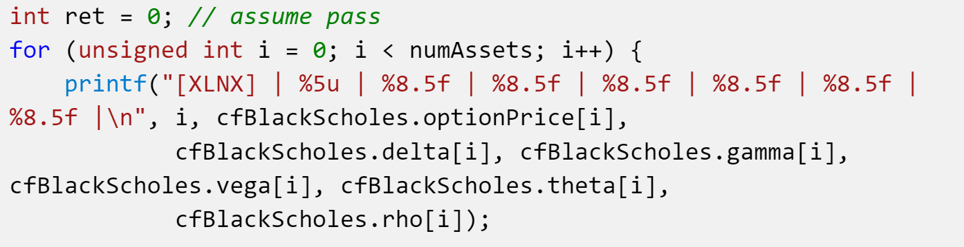
L3 Main
Run kernel
Print result

Slide 8
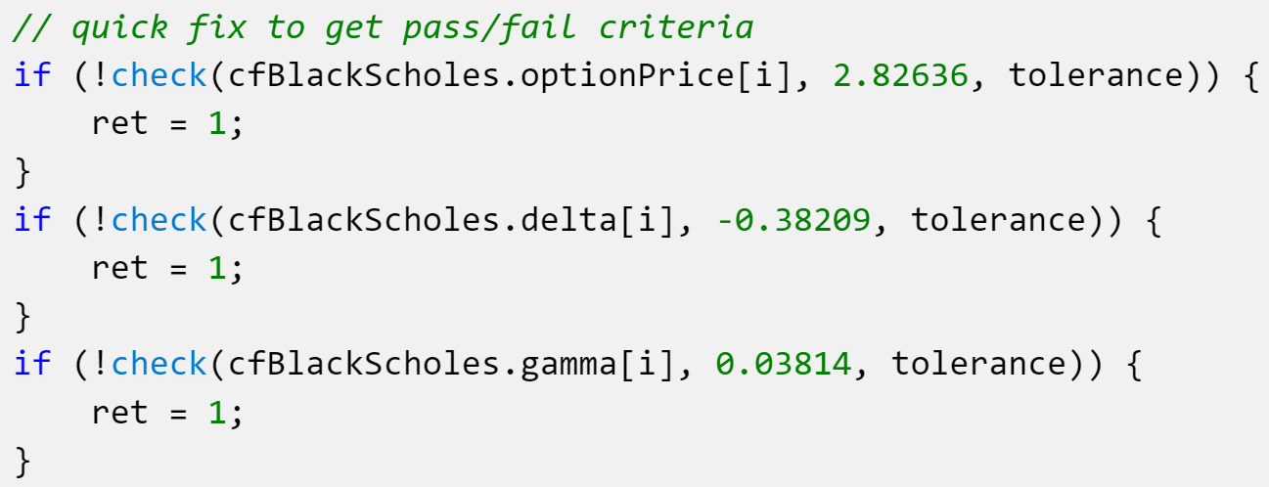
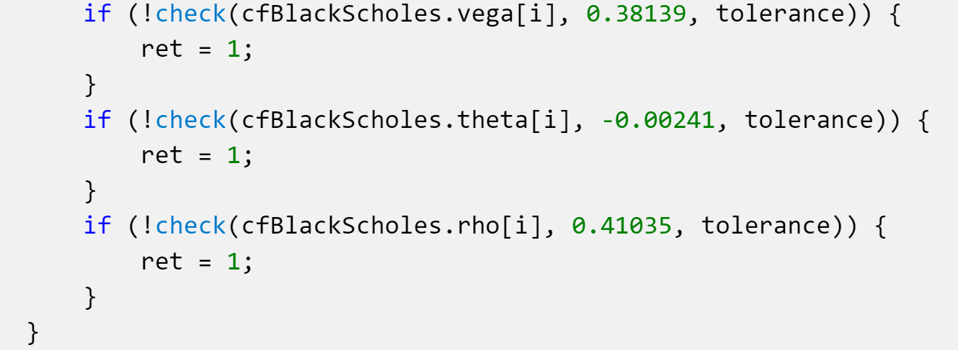
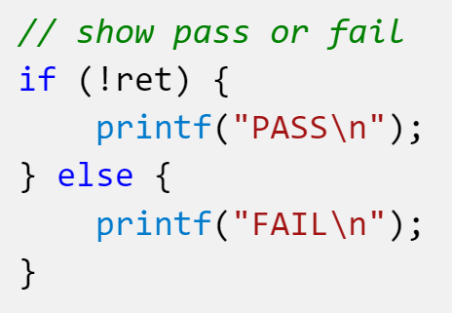
L3 Main
Check result

Slide 9
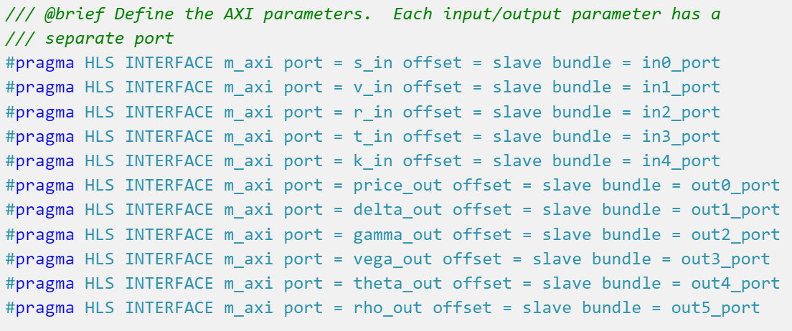
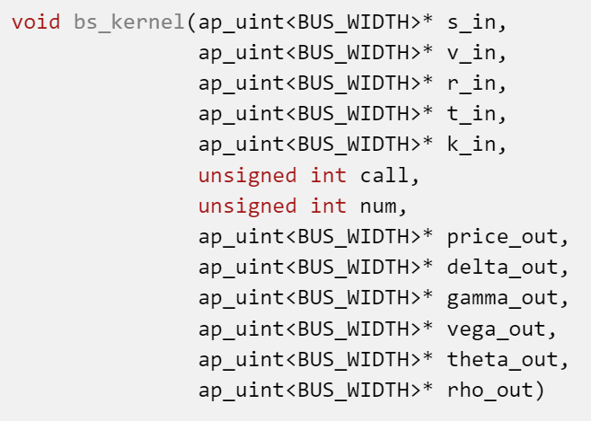
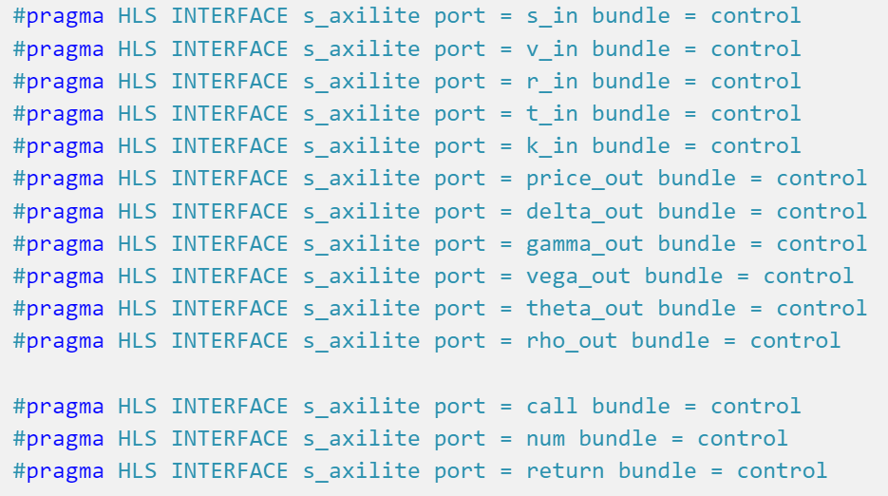
L2 bs_kernel Interface
Control signal for m_axi

Slide 10
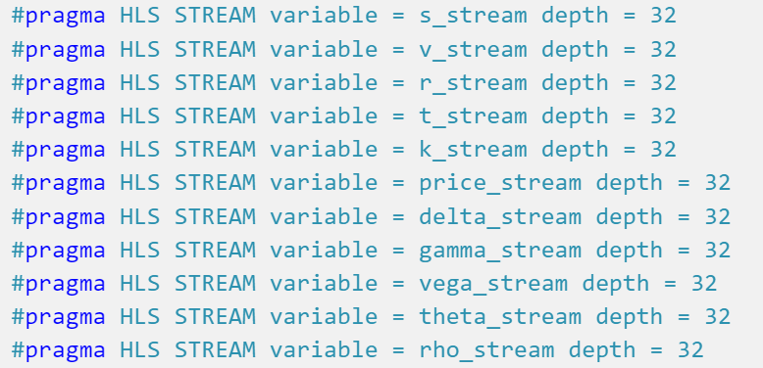
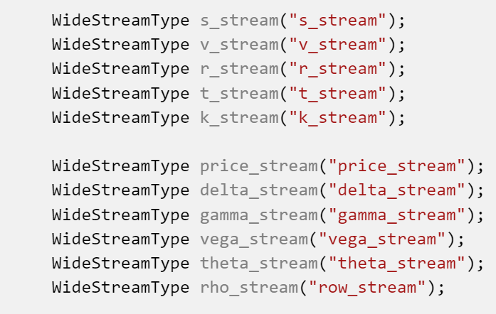
L2 bs_kernel Interface
Interface for bs_stream_wrapper: bs_stream_wrapper accepts only stream data
The stream is parallel stream

Slide 11
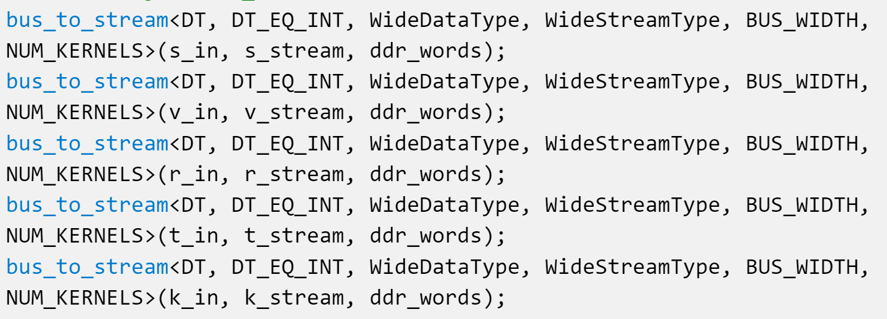
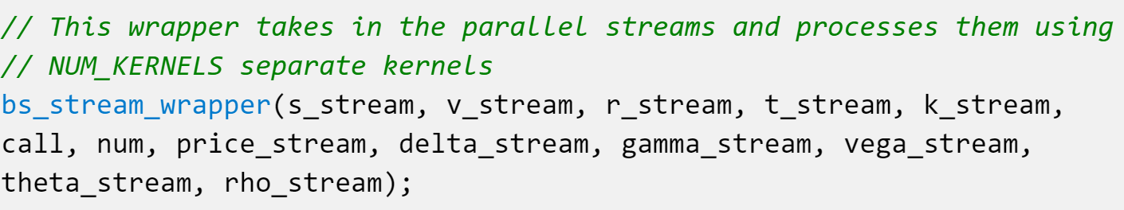
L2 bs_kernel
M_axi to stream
Compute

Slide 12
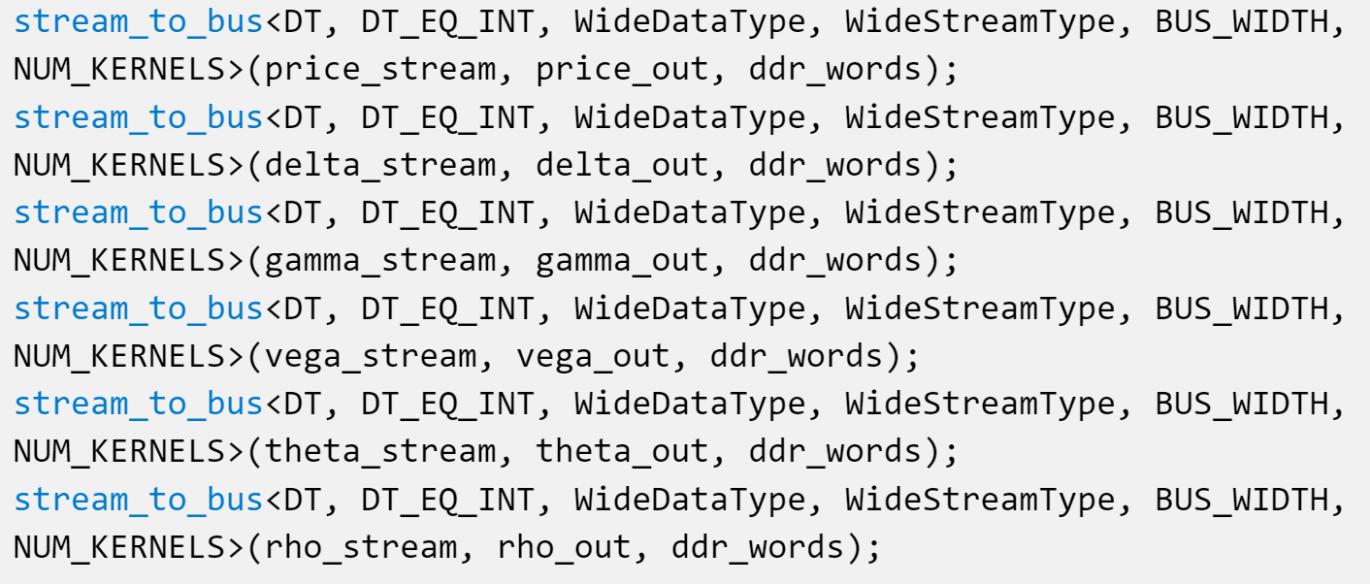
L2 bs_kernel
Stream to m_axi

Slide 13
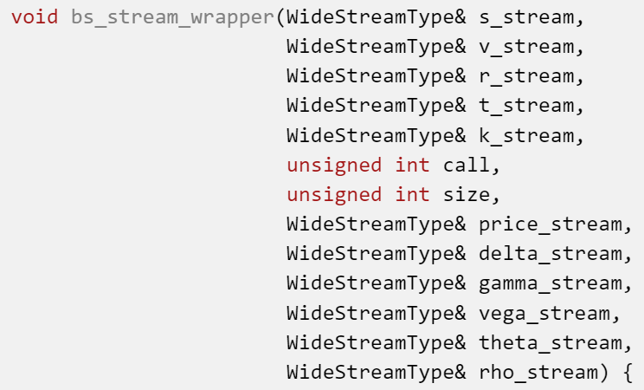
L2 bs_stream_wrapper Interface
The data type is user-defined WideStreamTpye, that is parallel stream type

Slide 14
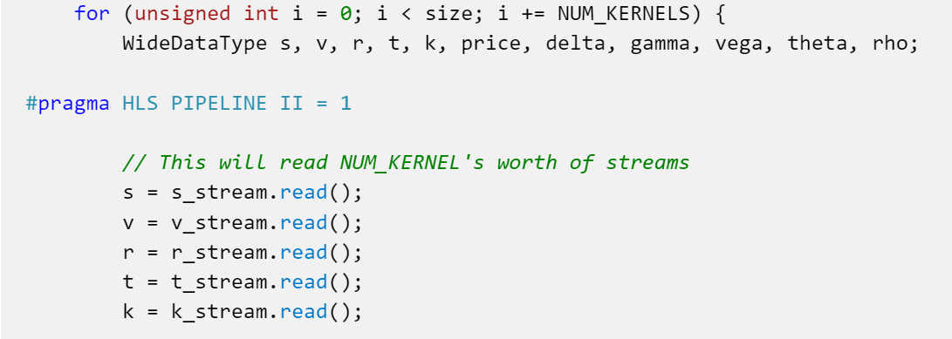
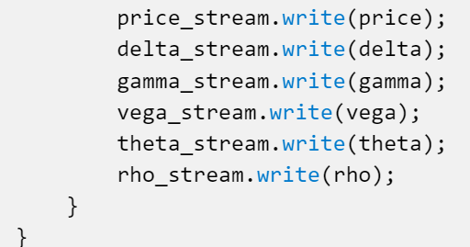
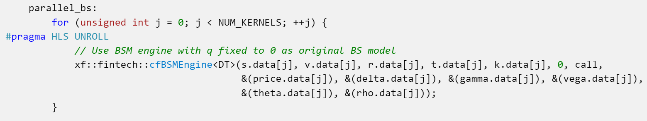
L2 bs_stream_wrapper
Use stream.read() to read input from stream and stream.write() to write output to stream.
Stream in
Stream out
Computing

Slide 15
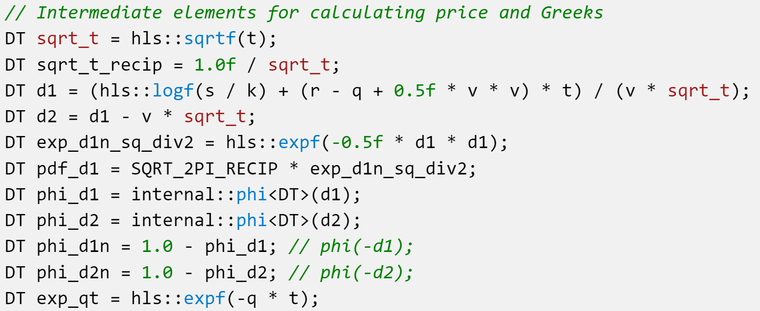
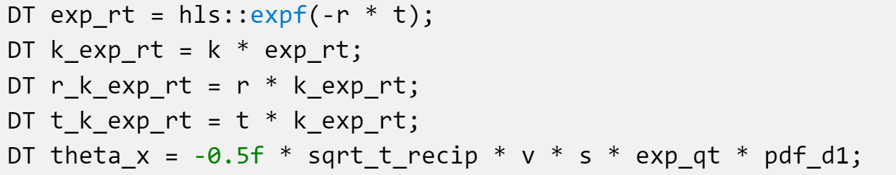
L2 cfBSMEngine
Intermediate Elements

Slide 16
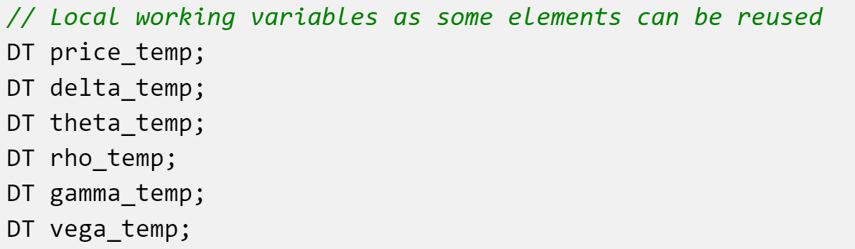
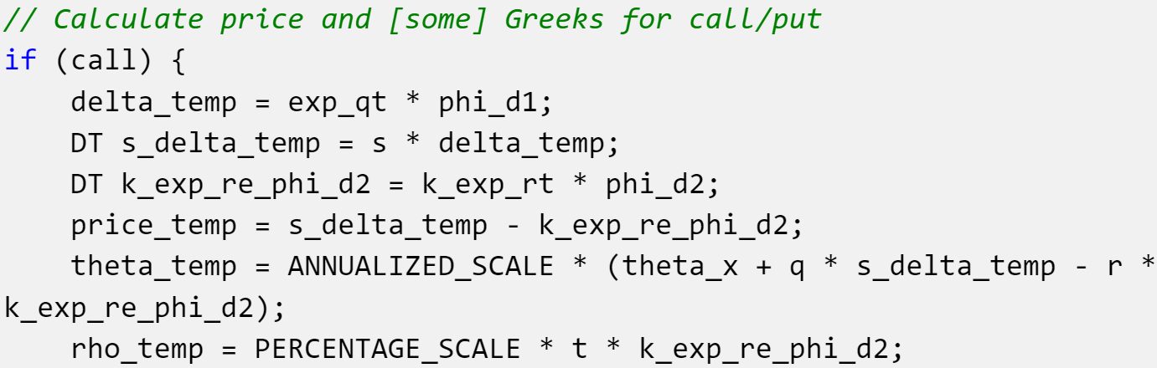
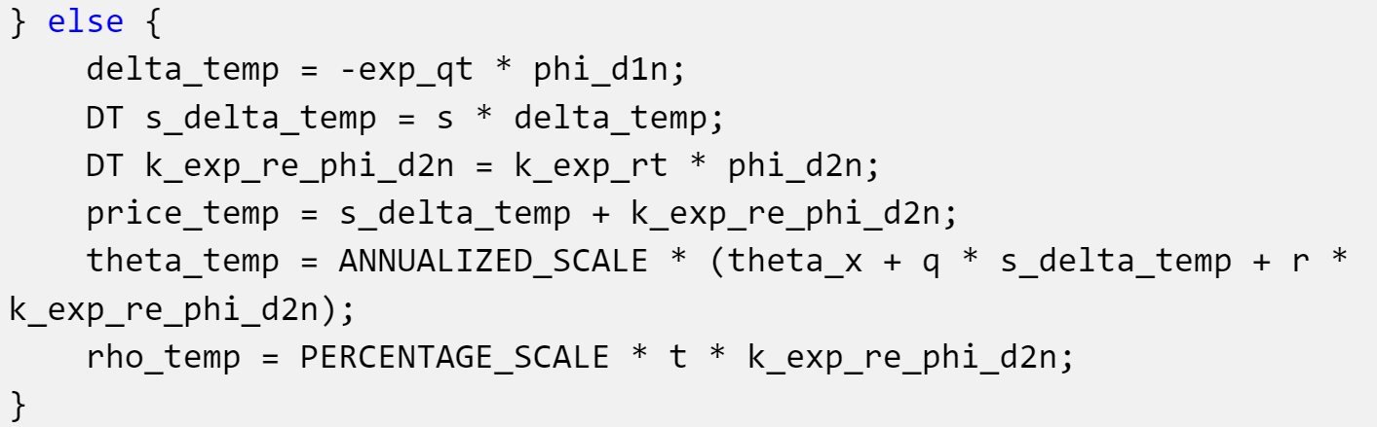
L2 cfBSMEngine
Compute according to call price or pull price
Call price Pull price

Slide 17
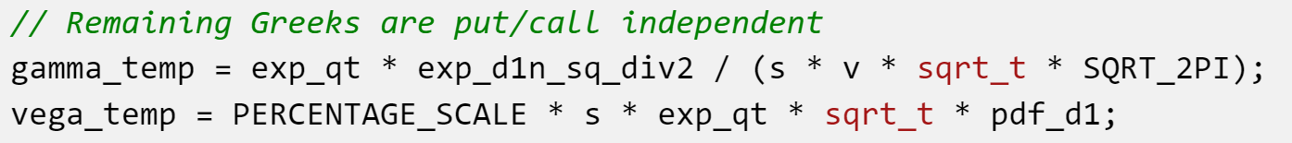
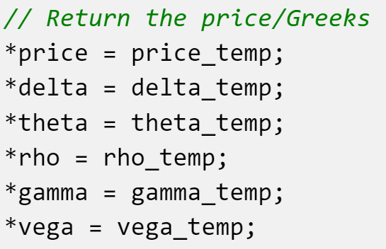
L2 cfBSMEngine
Post-Process
Output results

Slide 18
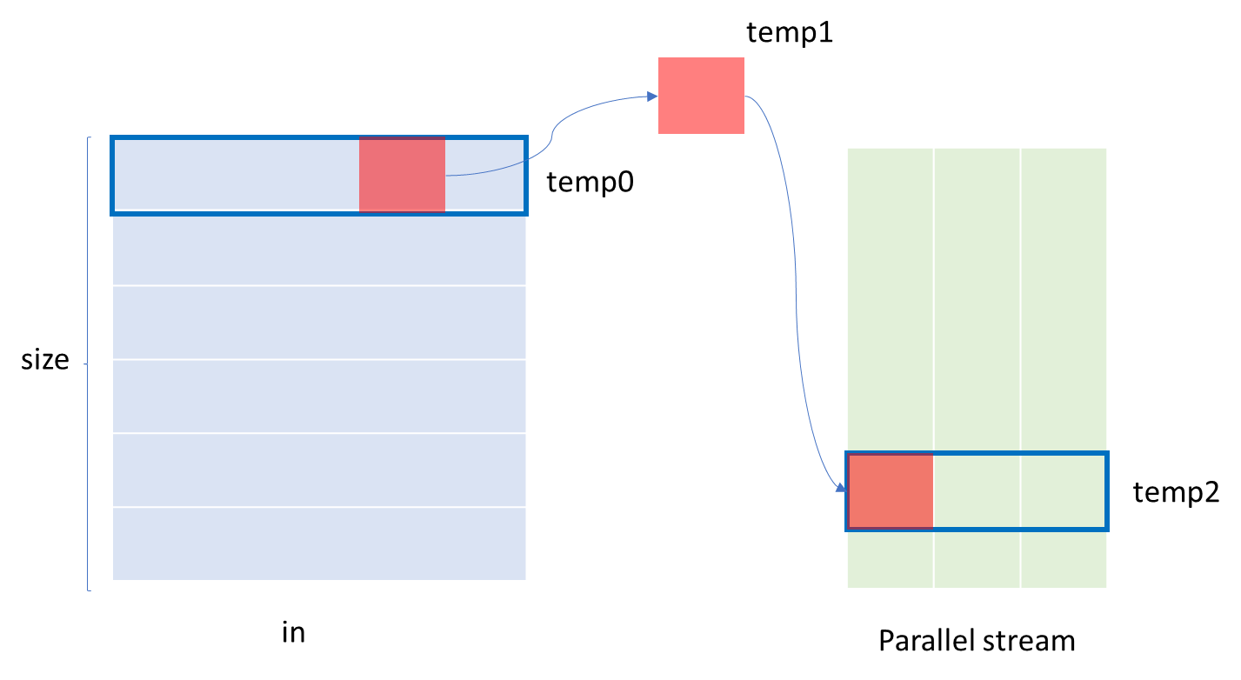
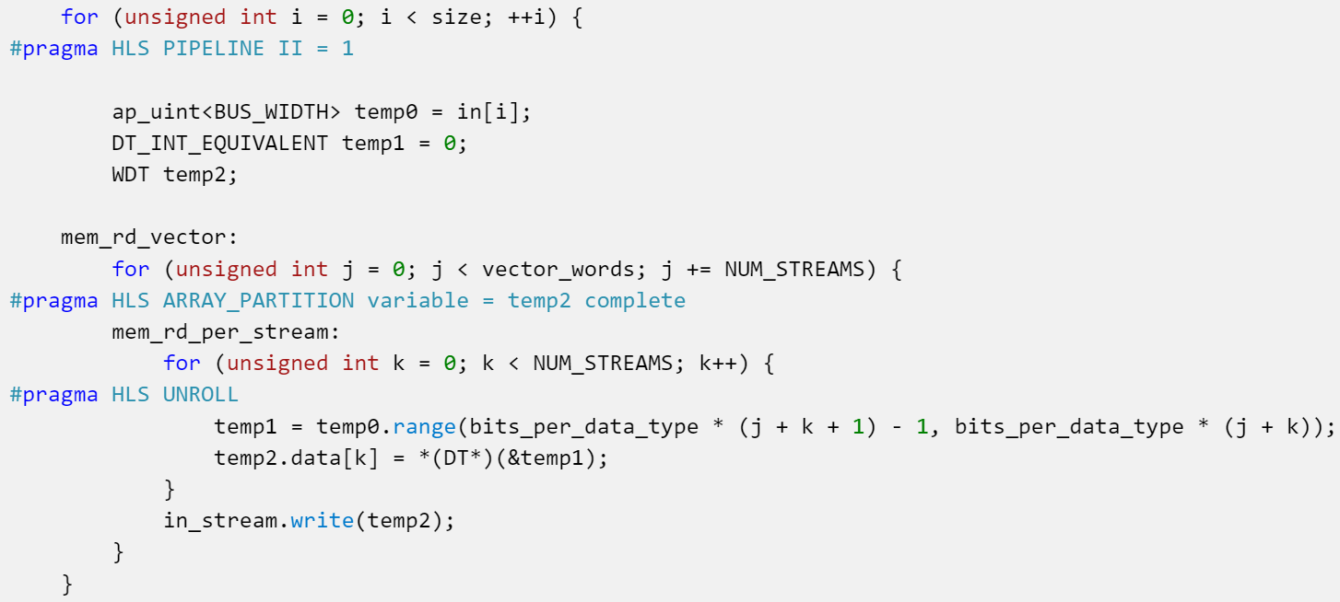
L2 bus_to_stream

Slide 19

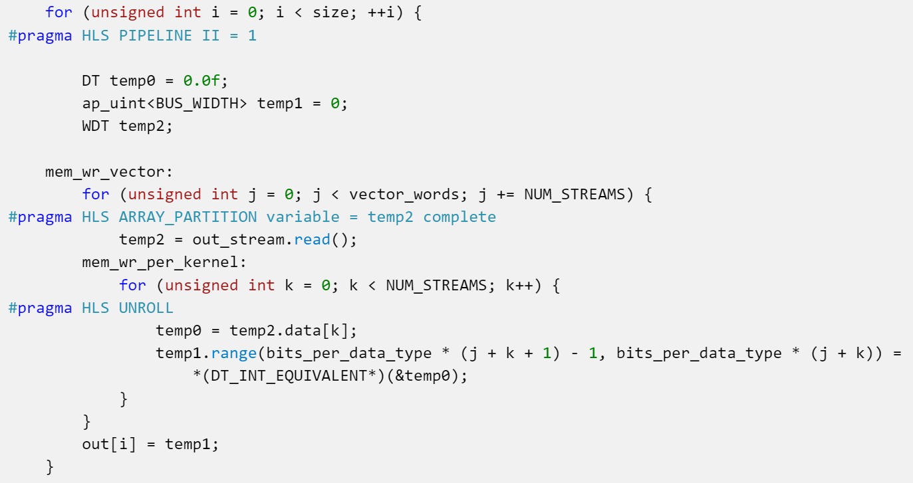
L2 stream_to_bus

Slide 20
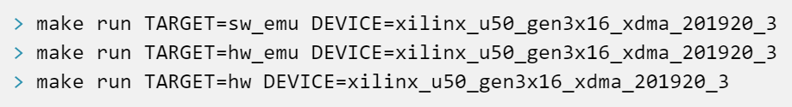
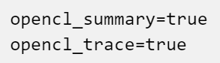
Development Process
Use Makefile
Enable to generate run_summary
Add the following commands to the beginning of Makefile

Slide 21
Report
SW emulation report
HW emulation report
HW report

Slide 22
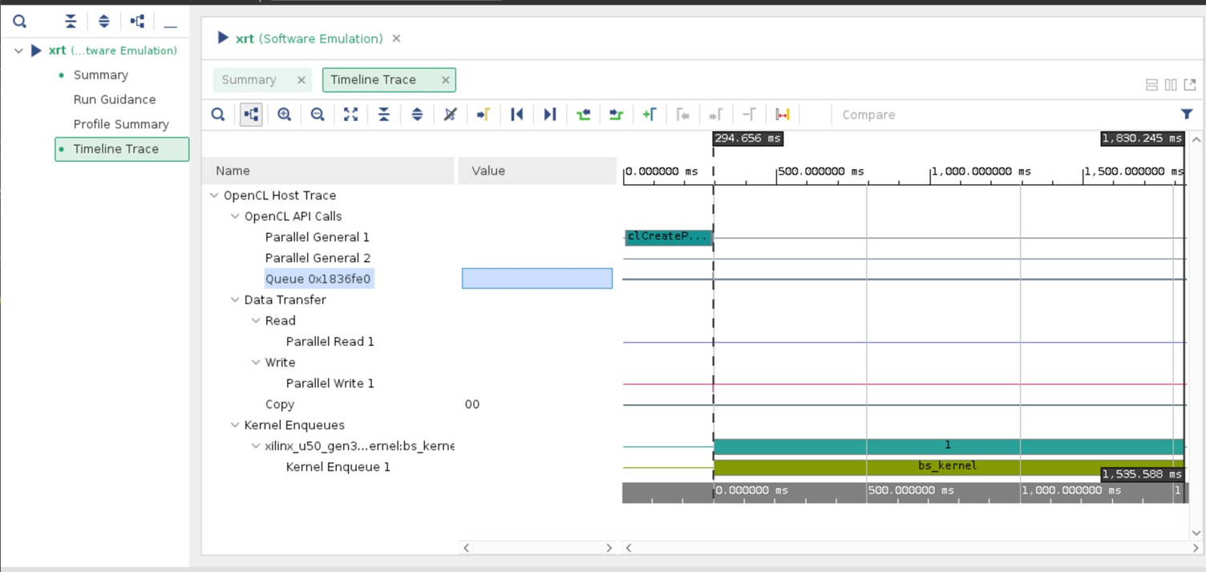
Software Emulation
Runtime for bs_kernel is 1.5ms

Slide 23
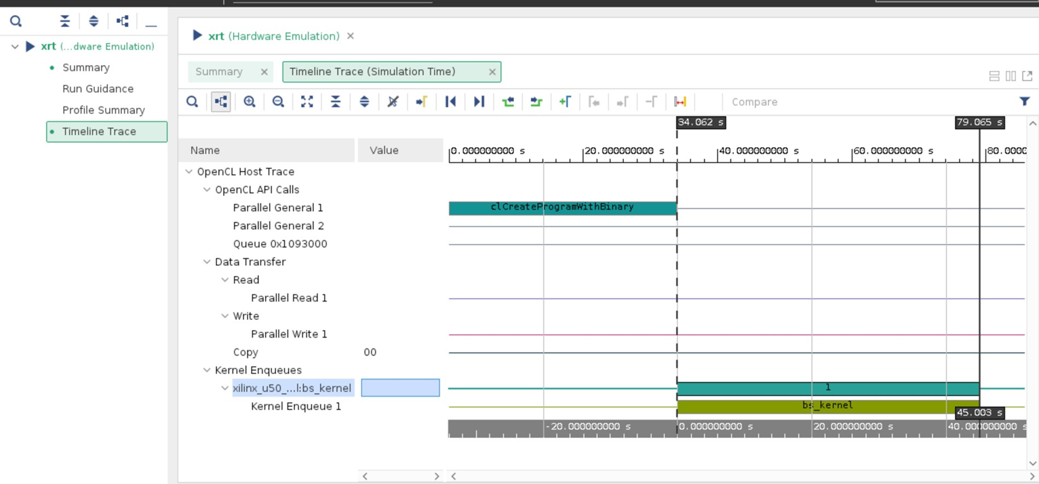
Hardware Emulation
Runtime for bs_kernel is 45s. Since the bs_kernel is transfer to RTL model to run Hardware Emu.

Slide 24
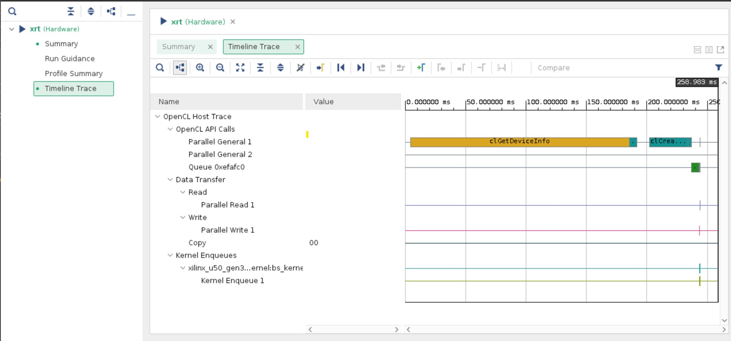
Hardware
Most of time is spent on getting device.

Slide 25
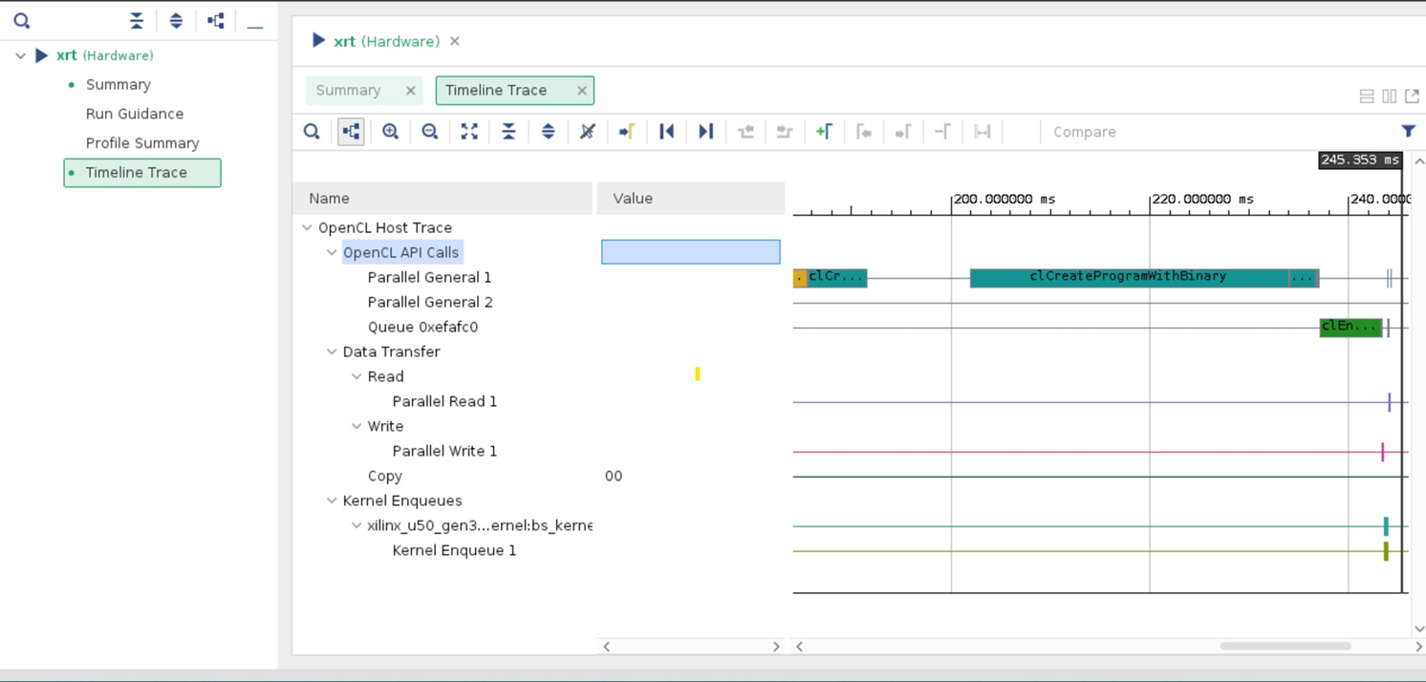
Hardware Program with Binary
The Host loads binary to U50

Slide 26
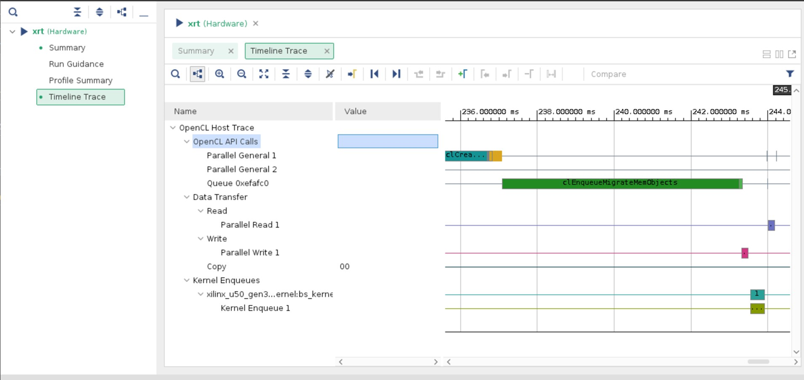
Hardware MigraMemoryObject
The host migrates memory object.

Slide 27
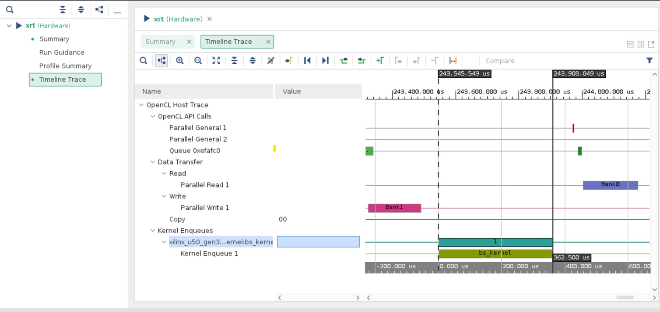
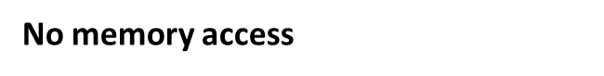
Hardware BSKernel
The real runtime on hardware for bs_kernel is 362.5us.

Slide 28
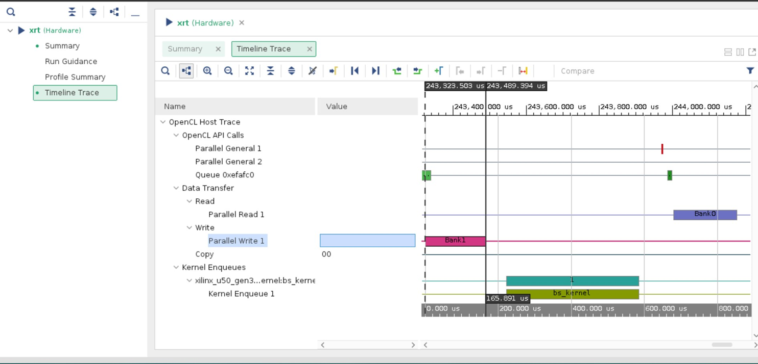
Hardware ParallelWrite
The real runtime for host to write all input to memory is 166us.

Slide 29
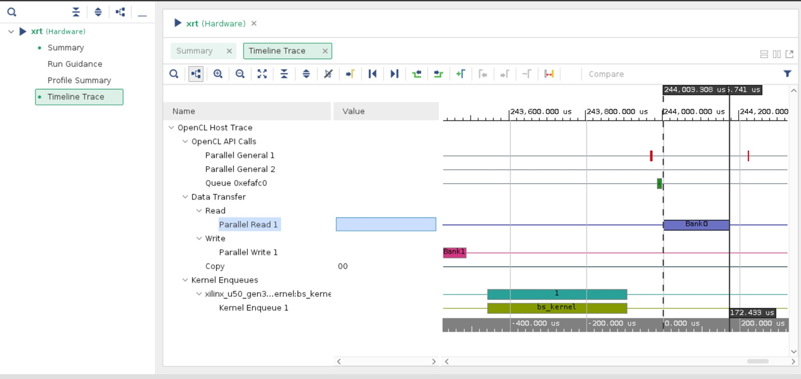
Hardware ParallelRead
The real runtime for host to read all output from memory is 172.4us.

Slide 30
Suggestion of Improvement
Write data to memory
bus_to_stream converts input data from m_axi to stream
bs_kernel_wrapper do computation
stream_to_bus converts output data to m_axi
Read output from memory
The current implementation:
We can change the prepared data type as stream and send to bs_kernel_wrapper. We can further decrease the timing by adjust the data type.
Write data to stream
bs_kernel_wrapper do computation
Read output from output stream

